Slide 1



Transitional concepts on desire, university and psychotherapy
koggz.nl
a.noordhof@uva.nl

Slide 2

"Psychotherapy is done in the overlap of the two play areas, that of the patient and that of the therapist. If the therapist cannot play, then he is not suitable for this work. If the patient cannot play, then something needs to be done to enable the patient to become able to play, after which psychotherapy may begin."
Winnicott 1971

Slide 3

What is my problem?
experience
relations
fears
desires
shame
enthusiasm
body
...
Thought
Books
Philosophy
University
Science
Research
Lectures
...
Notes:
Uit interview met Jenny!

Slide 4
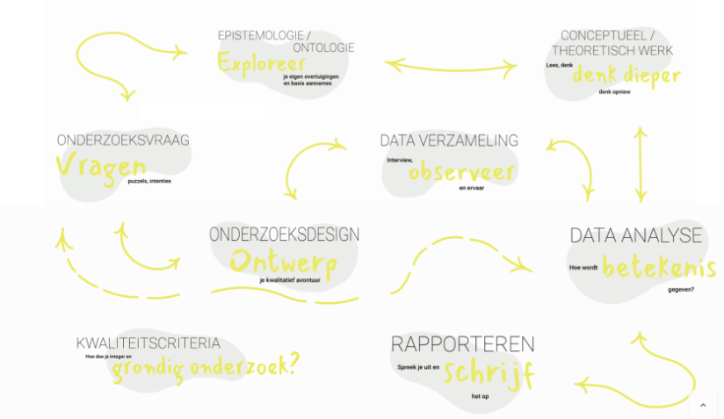

Slide 5
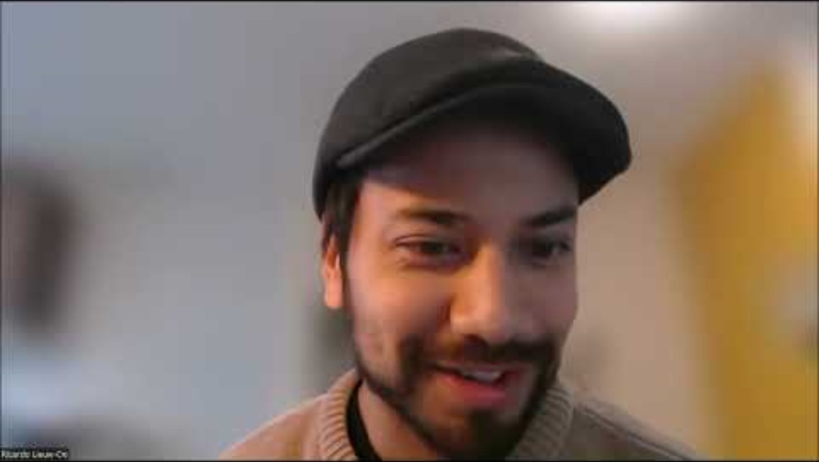

Slide 7
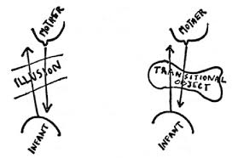
Triad of clinical thinking
3. Concepten
(what does it mean?)
2. Observations
(how does it appear?)
1. Experiences
(what is it about?)

Slide 8
Transitional object and transitional space
Submission to
external reality
Objective
False Self
Subjective
Retreat into
fantasy

Slide 9
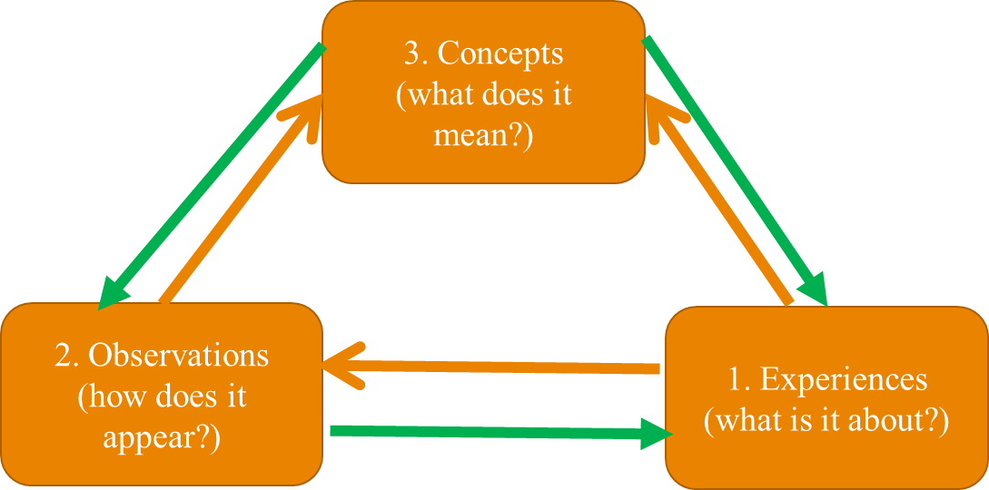
Embedded in historical discourse
“We think”
Past
Future
Social discourses
“transitional (use of) concepts”
Professionals
Clients

Slide 10
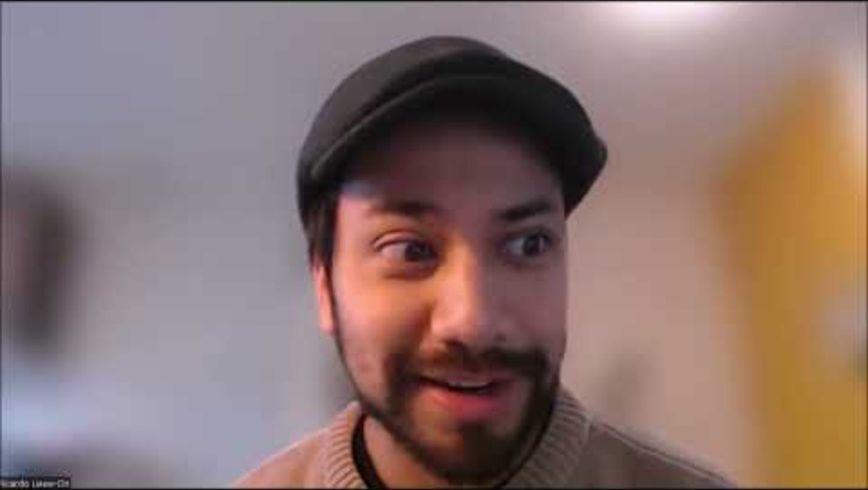

Slide 12
Good enough...
Select one relevant, interesting concept
Small diverse sample: 10-15 experts
  Purposive sampling, saturation principle
Interviews
Thematic analysis

Slide 13
Interview
“In this interview I want to focus on the therapeutic situation in the context of individual therapy and not group therapy. In a therapeutic situation, a client may have all kinds of experiences towards you as a therapist. But it also happens that you as a therapist have experiences in relation to the client. I want to talk about your experiences as a therapist towards the client. Could you tell me something about your experiences with it?”

Slide 14
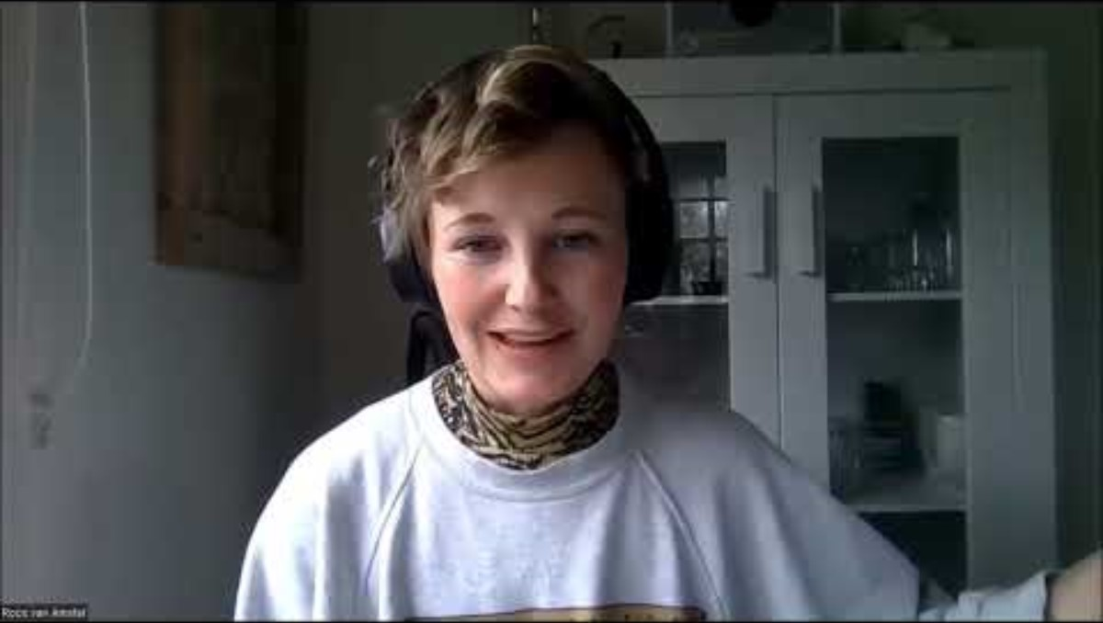

Slide 16
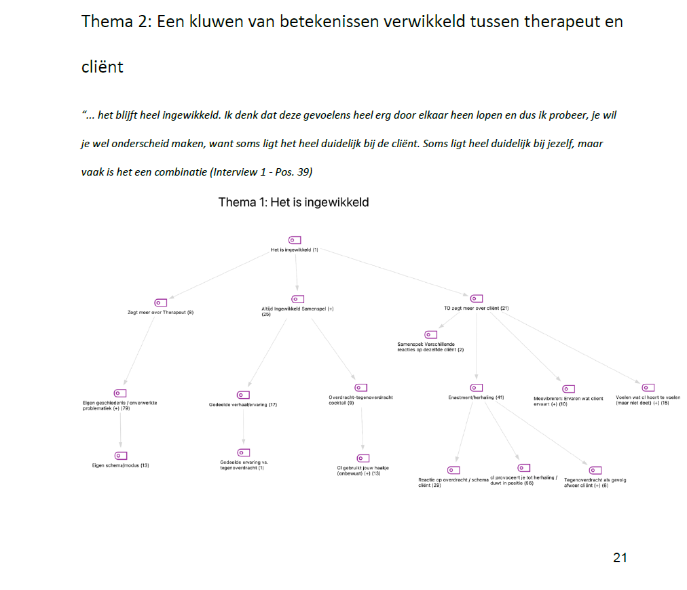
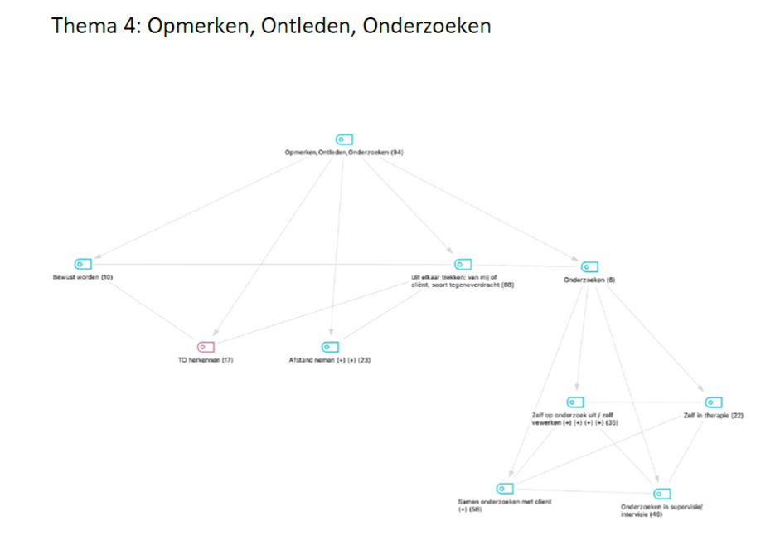
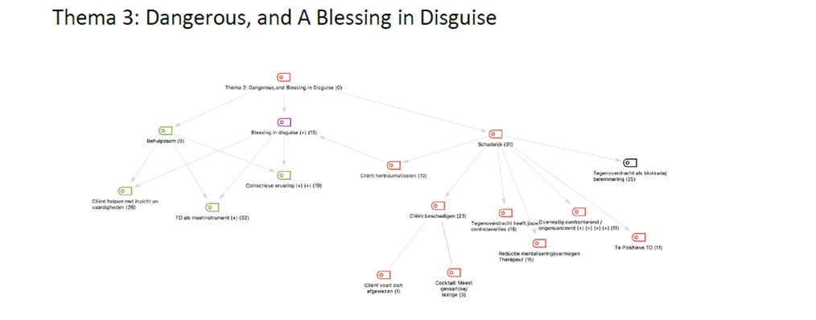
Thematische analyse
Theme 2: A tangle of meanings intertwined between therapist and client.
“… it remains complicated. I think these feelings are very intertwined and so I try… you still want to distinguish… because sometimes it is very much what comes from the client. Sometimes very much from you, but very often it is a combination.”

Slide 17
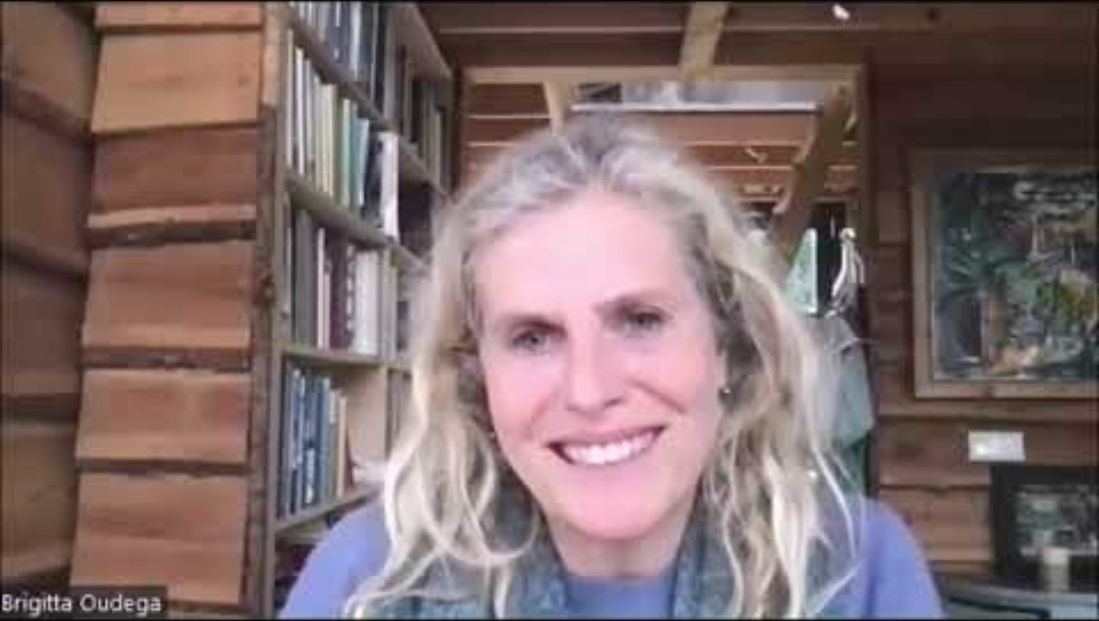

Slide 19
Conclusions?
Therapists seem to define countertransference broadly, but apply it more narrowly, and they seem to handle multiple specific meanings simultaneously.
Certain specific meanings appear more transtheoretical, while others seem more therapy-specific.
The meaning that therapists give to countertransference is closely related to actions aimed at therapy outcomes and progression.

Slide 20
Reflexivity
Examine your subjectivity:
Desires
Pre-conceptions
Background
Socio-cultural position
Personal experiences
“[…] Secondly, these previous personal experiences together with a desire to become a psychotherapists have focussed me on the question “how to deal with countertransference?”. Through this my perspective has probably been shaped in the direction of observing and analysing how meanings and definitions of countertransference are connected to ways of dealing with it in order to improve the course and outcome of therapy. […]”

Slide 21
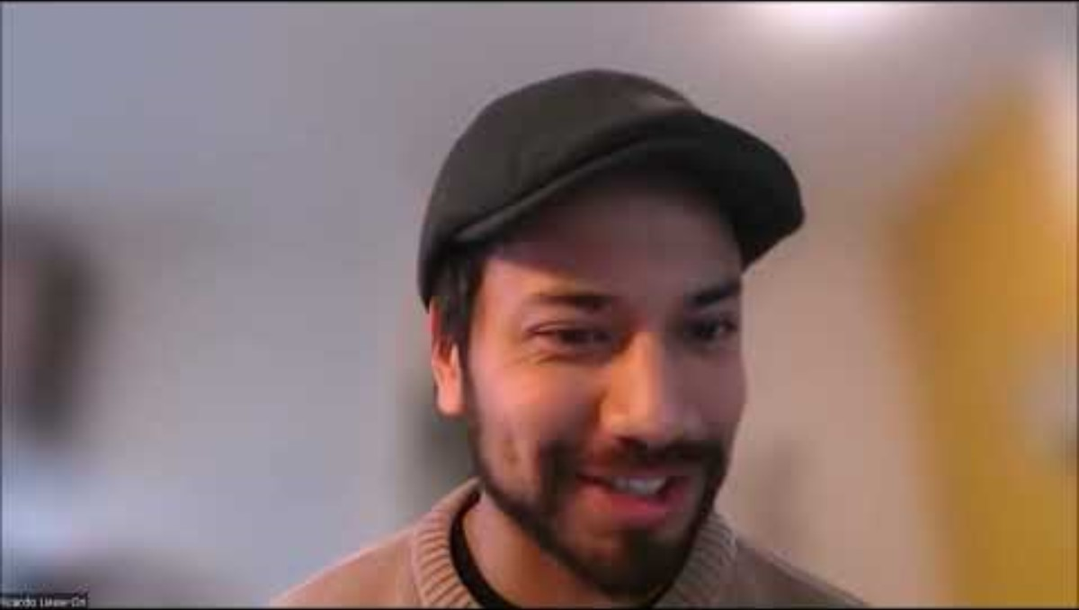

Slide 22

And did it satisfy my desire?
Not yet...

Slide 23
What’s next?
Kwalitatief Onderzoekscollectief GGZ (KOG) wants to improve Dutch mental healthcare by promoting qualitative research:
Connect individuals
Increase the quantity
Improve the quality
Share the results

Slide 24
Why? a split in our present psychology
Mathematics, biology, history, sociology, philosophy, political economy, anthropology, hermeneutics, phenomenology, ethics, etc.
Confirmatory science, experimentalism, mathematics, biology
submission
The full
‘alma mater’
sciences
Scientism
False self
transitional
spaces
Free person
True self
Pure intuition
Pseudoscience
Anti-science
Alternative facts
Desiring scholars, teachers, therapists, patients
Subjectivism
Retreat into
fantasy
subjects

Slide 25

How?
Internships and master theses
PhD projects: ‘experiences with psychosis’, ‘pattern diagnostics’, ‘experiences with emotion-focused family intervention’
Symposia KOG
Intervision and learning collectives KOG
Research Master course “Qualitative Research in mental health science” together with Lisa Wijsen
Consultations and collaborations
And…. play

Slide 26
Questions?
koggz.nl
a.noordhof@uva.nl

