Slide 1




Outside in
Grant
support
Impact
Developer
Communication
support
Business
Developer
Societal
Partners
Research & Education
Commercialization
support
Inside out

Slide 2
Drive
  Interim coordinator and leader
  Provide own view
  Selected operational activities
Coach
  Methods, knowledge support
  Pro-active input
  Selected deep dives
Enable
  Connecting
  Promoting
  Explaining

Slide 3
How can we, as researchers, effectively reach out and communicate our findings to policymakers?

Slide 4
How can policymakers effectively reach out to researchers and communicate their needs?
And what can we do to facilitate that?

Slide 5

1. Have an output that is not a paper.
2. Involve the policymaker.
3. Identify what the policymaker needs.
2. Involve the policymaker. Really involve them.
Inside out
How can we, as researchers, effectively reach out and communicate our findings to policymakers?

Slide 6

1. Have an output that is not a paper.
2. Involve the policymaker.
3. Identify what the policymaker needs.
2. Involve the policymaker. Really involve them.
Which means…
1. To adapt.
2. To be visible.
Outside in
How can policymakers effectively reach out to researchers and communicate their needs?
3. To tell a story that is true but also contains some bluffing.

Slide 7


To adapt
Exploring the creative tension between impact and autonomy
Example 1
Working with the Municipality of Amsterdam
Example 2
Working with Lidl

Slide 8

To be visible
Tap into the right channels
Clarity
Aesthetics
Example
OCW Kennisfestival

Slide 9
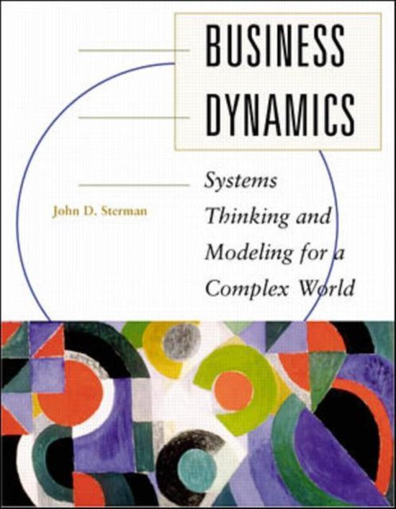
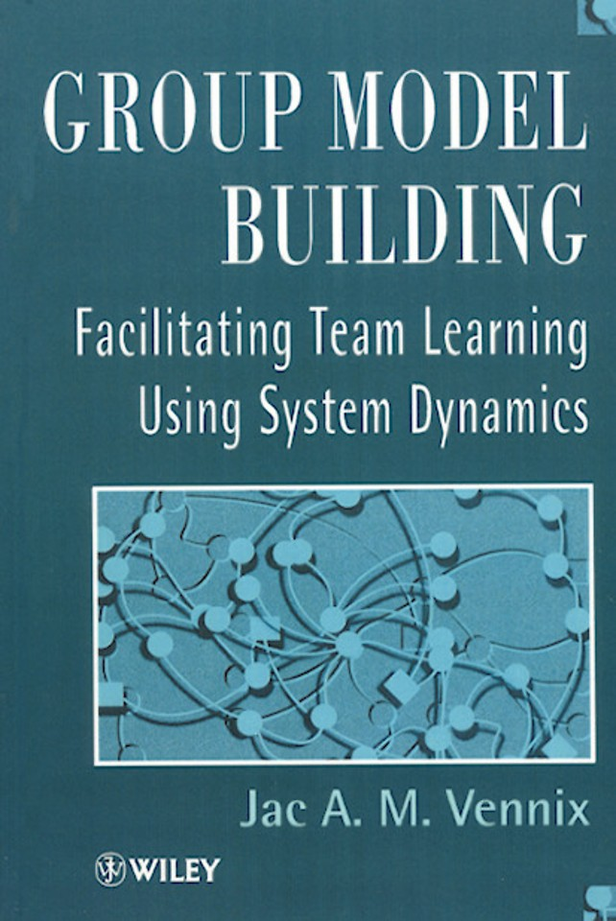
How to reach these goals?
Create an environment that supports mutual learning
Participants questions their assumptions instead of “winning the argument”
Crielaard, L., Uleman, J. F., Châtel, B. D., Epskamp, S., Sloot, P., & Quax, R. (2022). Refining the causal loop diagram: A tutorial for maximizing the contribution of domain expertise in computational system dynamics modeling. Psychological Methods.
Crielaard, L., Nicolaou, M., Sawyer, A., Quax, R., & Stronks, K. (2021). Understanding the impact of exposure to adverse socioeconomic conditions on chronic stress from a complexity science perspective. BMC medicine, 19(1), 1-20.
Merabet, N., Lucassen, P. J., Crielaard, L., Stronks, K., Quax, R., Sloot, P. M., ... & Nicolaou, M. (2022). How exposure to chronic stress contributes to the development of type 2 diabetes: A complexity science approach. Frontiers in Neuroendocrinology, 65, 100972.
But also: Rouwette, Richardson, Hovmand ...
Notes:
How do we achieve these goals? Much research has been carried out on the matter, some of the most established work and book are … They provide techniques that enable the workshops organizers to
Create an environment in which participants learn from one another
And question their assumptions instead of trying to ‘win the argument’

Slide 10
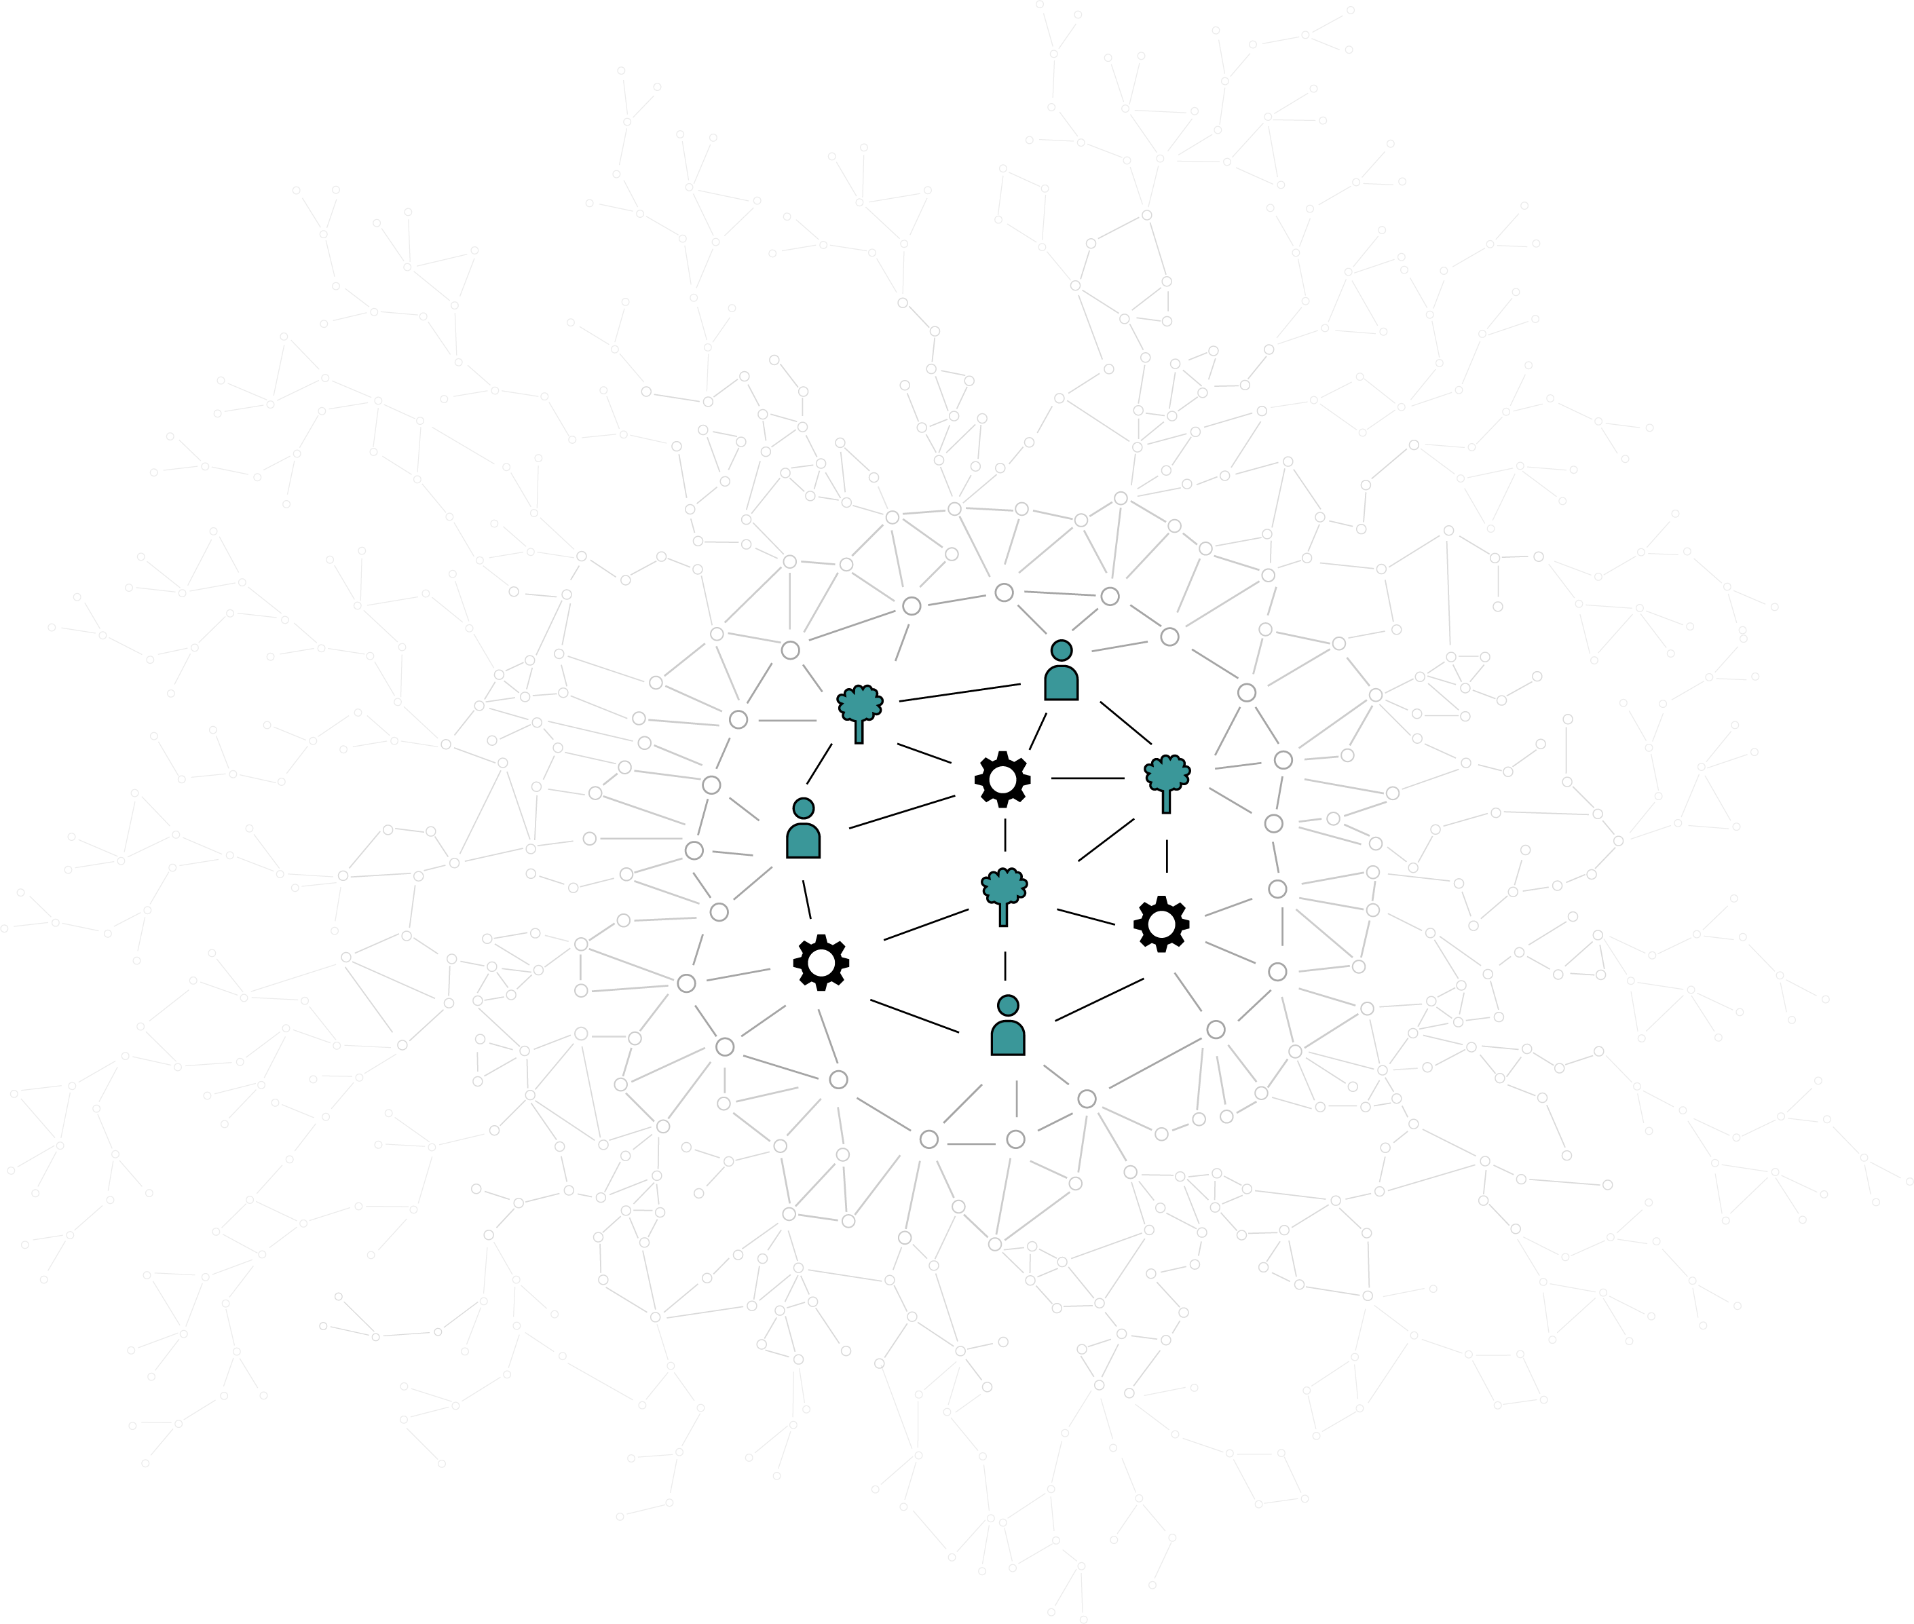

How to unravel complex problems?
1.
Developing the problem understanding from a multistakeholder perspective.
2.
Deep dive into the dynamics and behaviours at play in the context of the problem.
3.
Modelling and simulating potential
systems interventions.

Slide 11
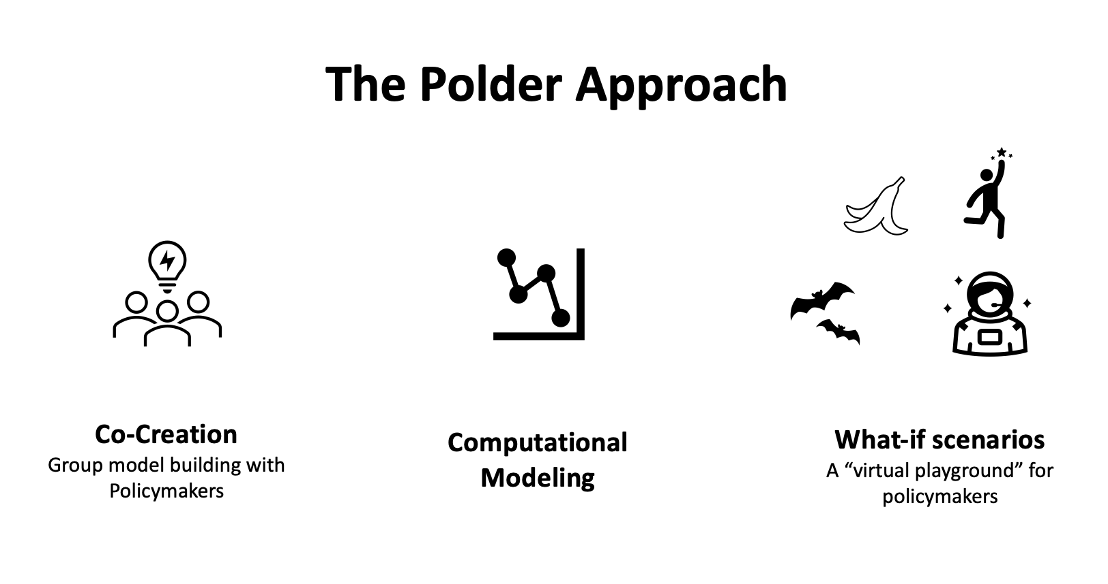
The Polder Methodology
Causal Loop Diagrams

Slide 12
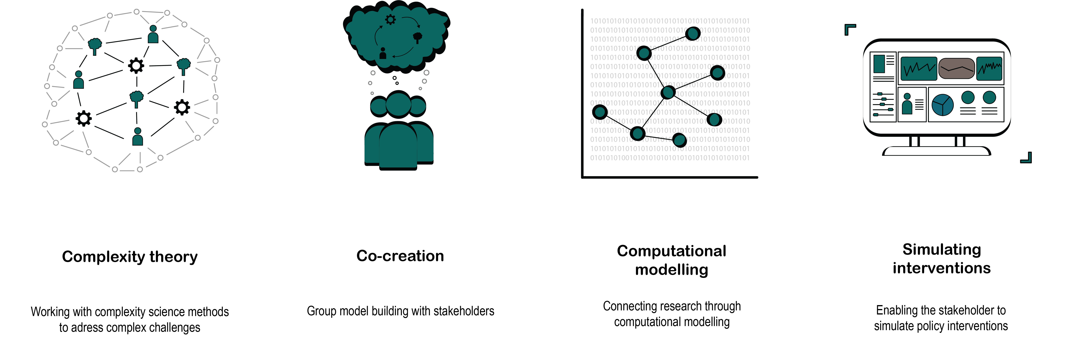


Slide 13

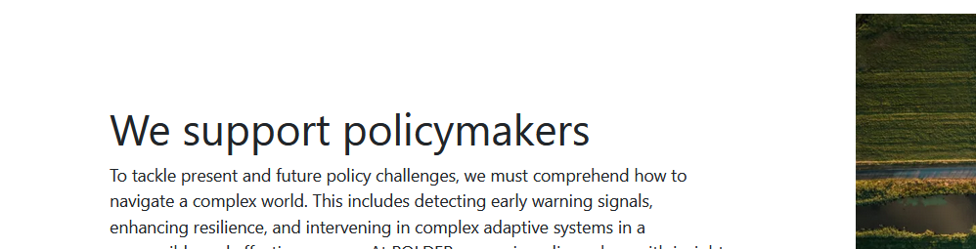

To tell a story that is true but also contains some bluffing.

Slide 14
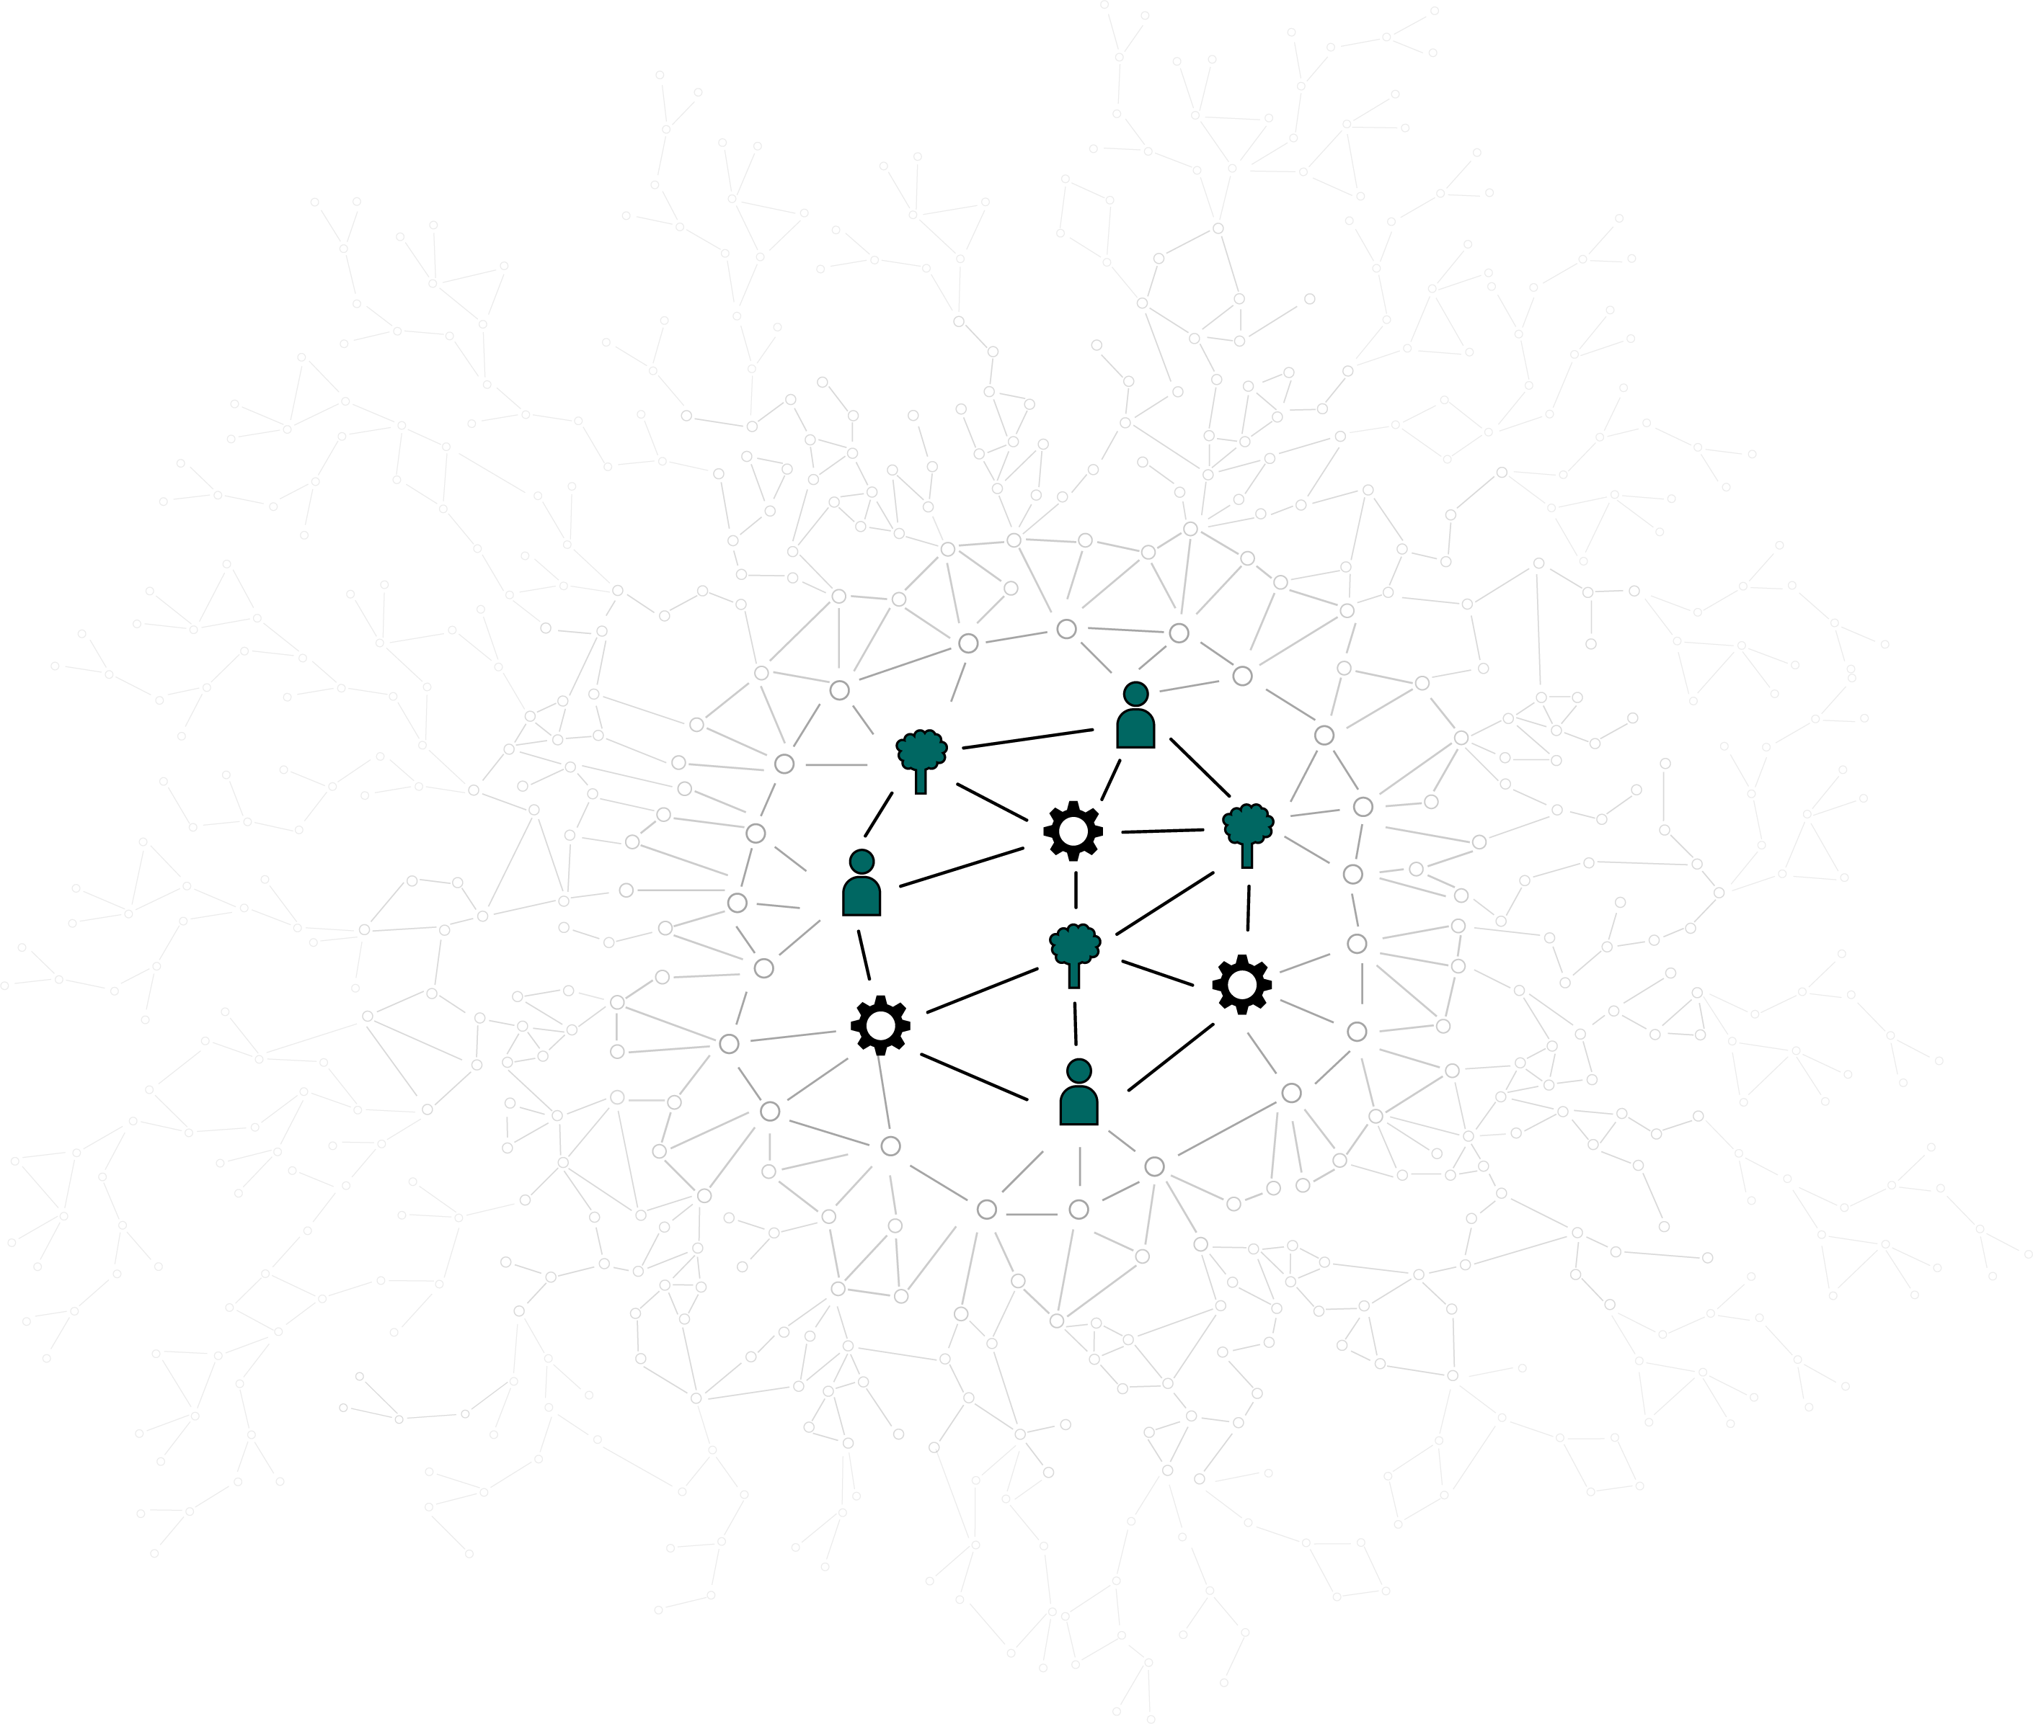
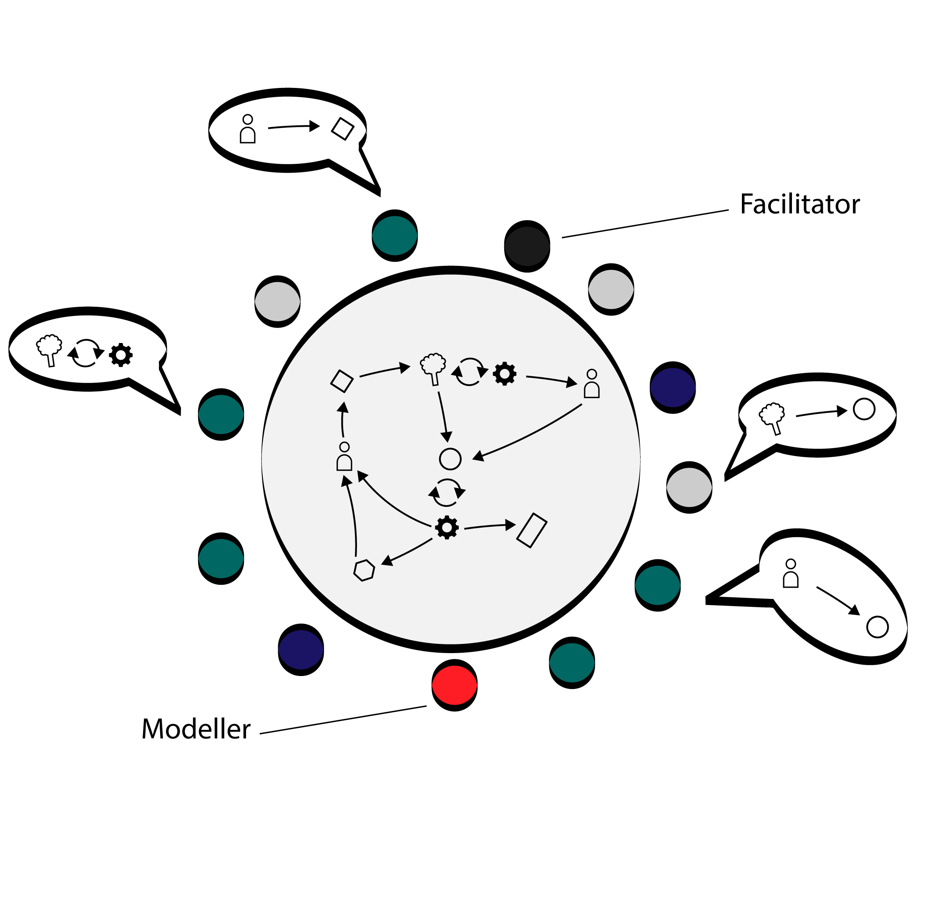
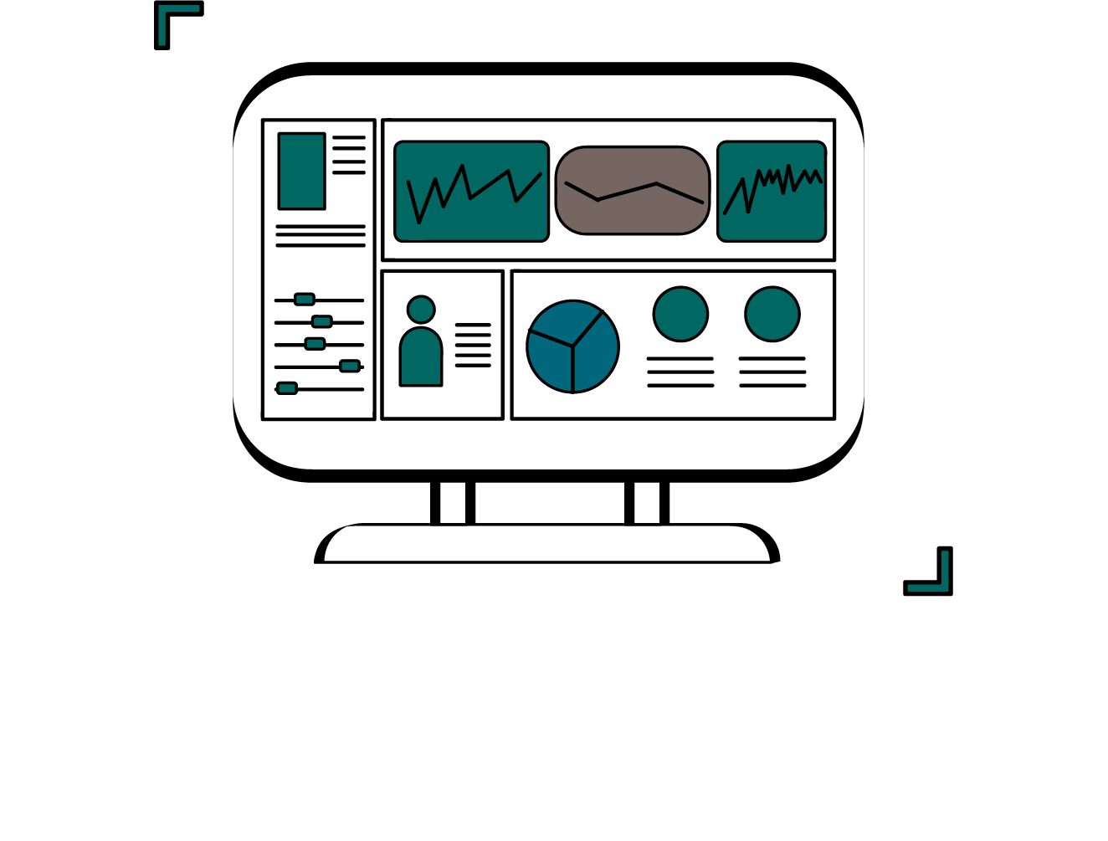
Have an output that fits their need. And ours.
1. Participatory modelling
2. Policy simulations
3. Field experiments

Slide 15
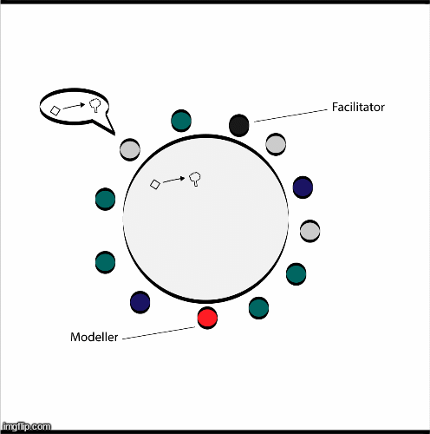
Involve the policymaker stakeholders.
Really involve them.
Find a transdisciplinary method that works for you

Slide 16
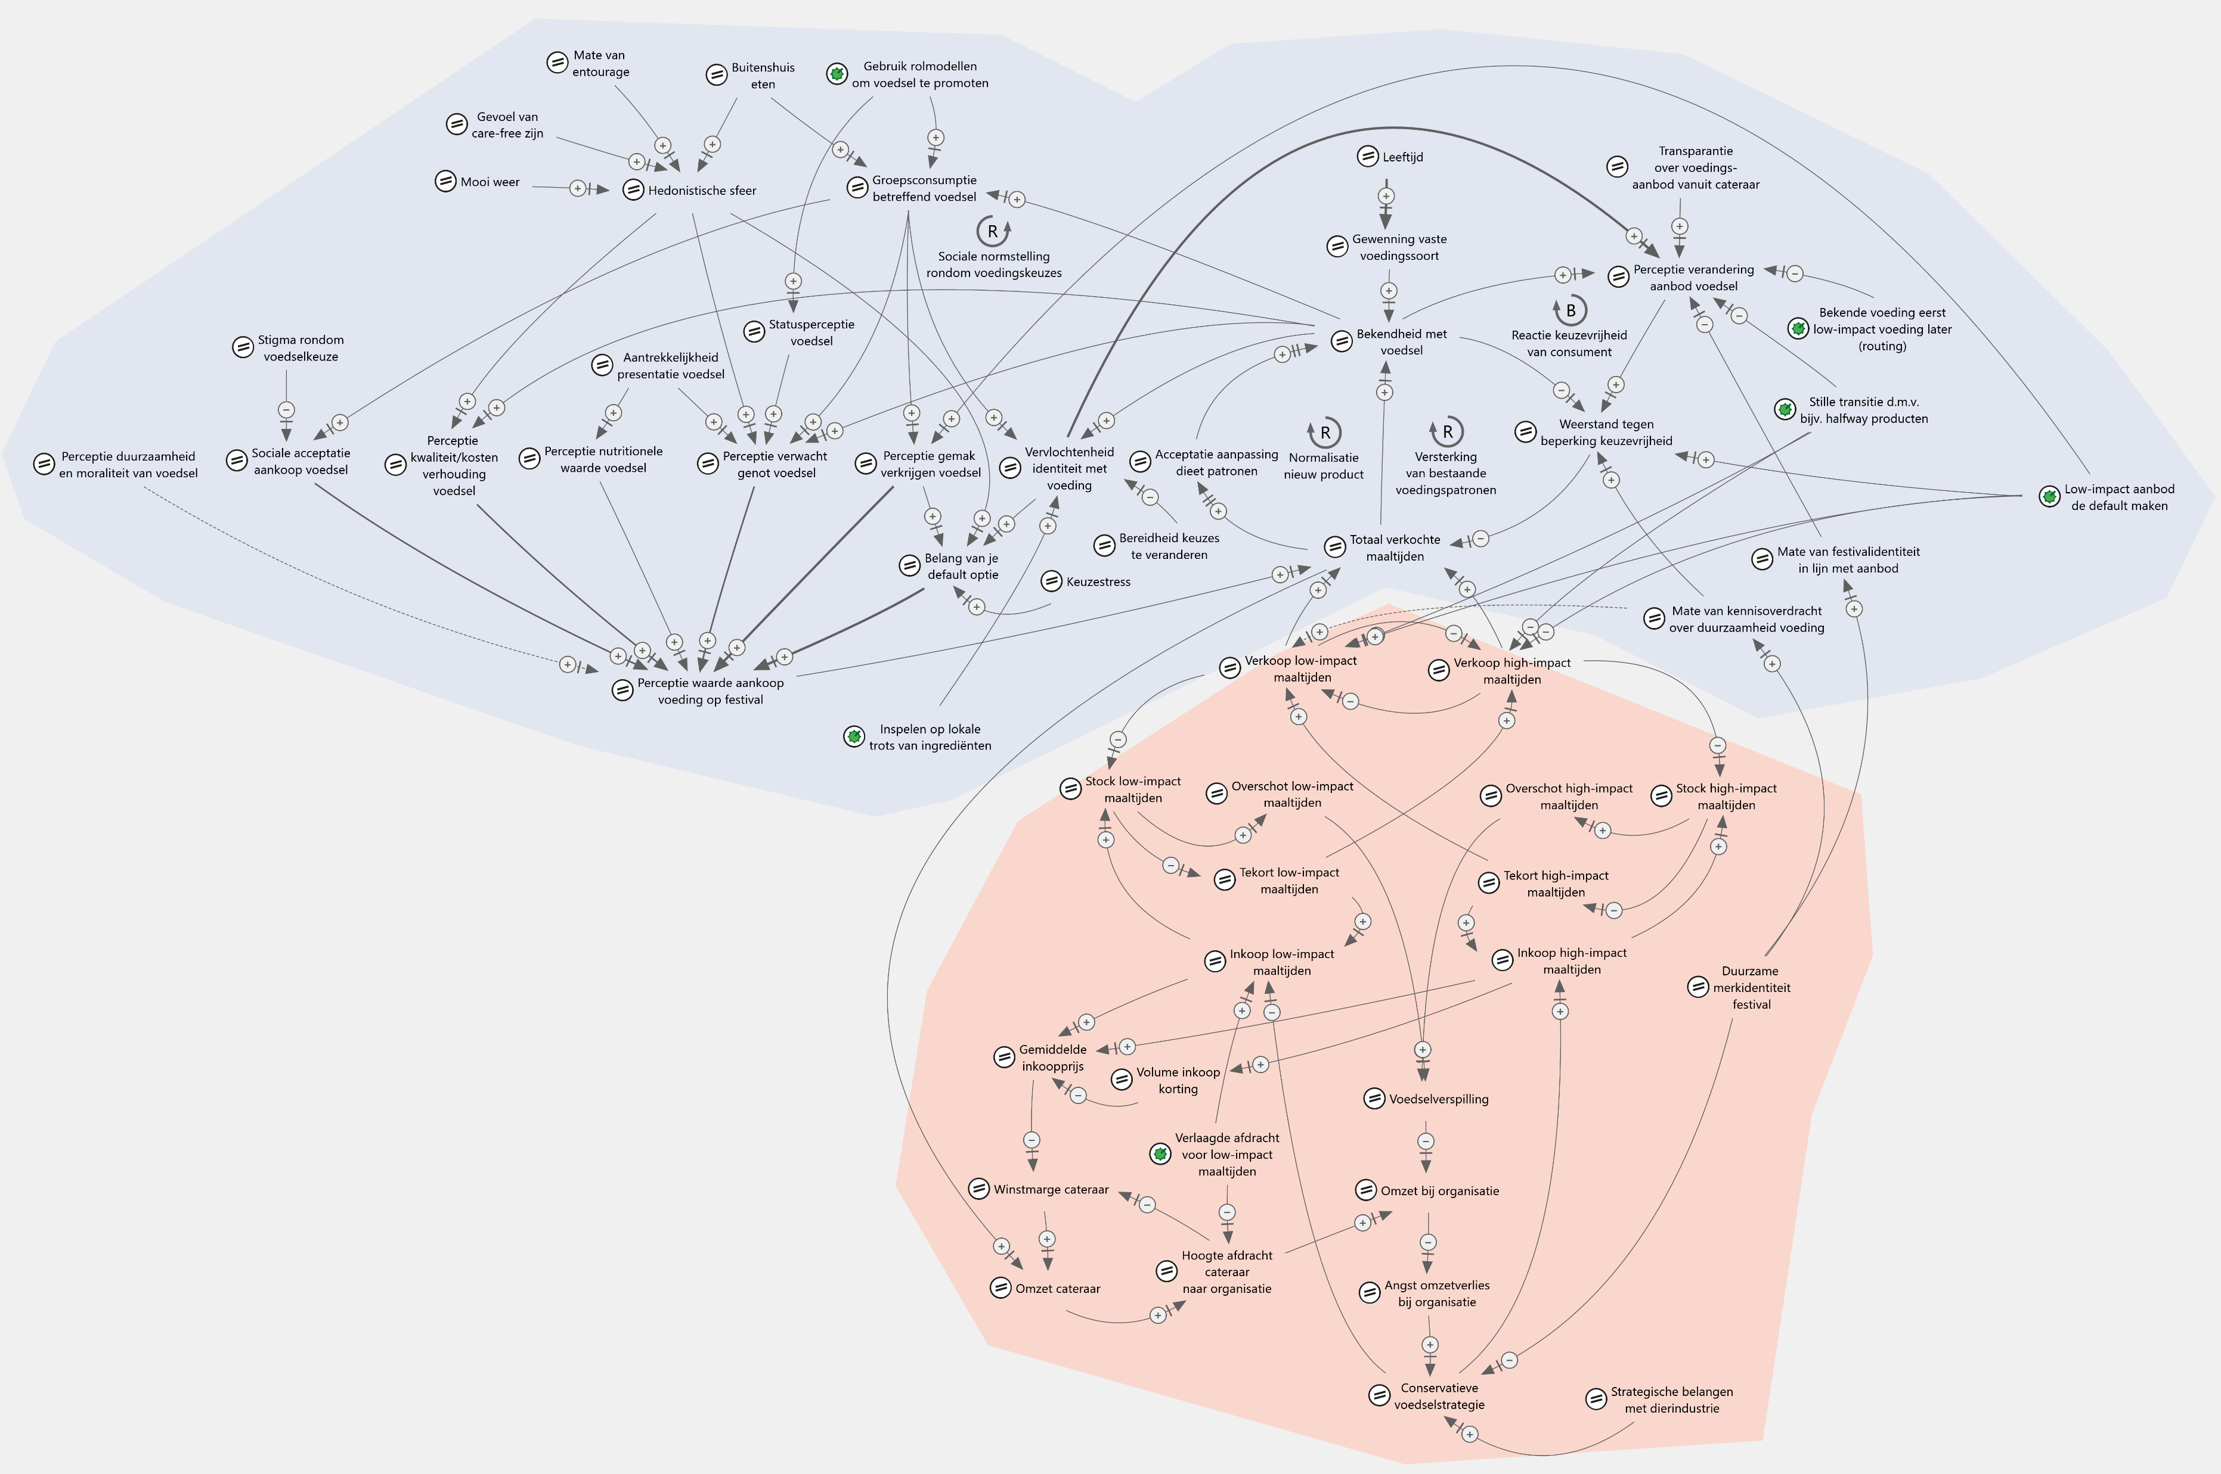

Slide 17
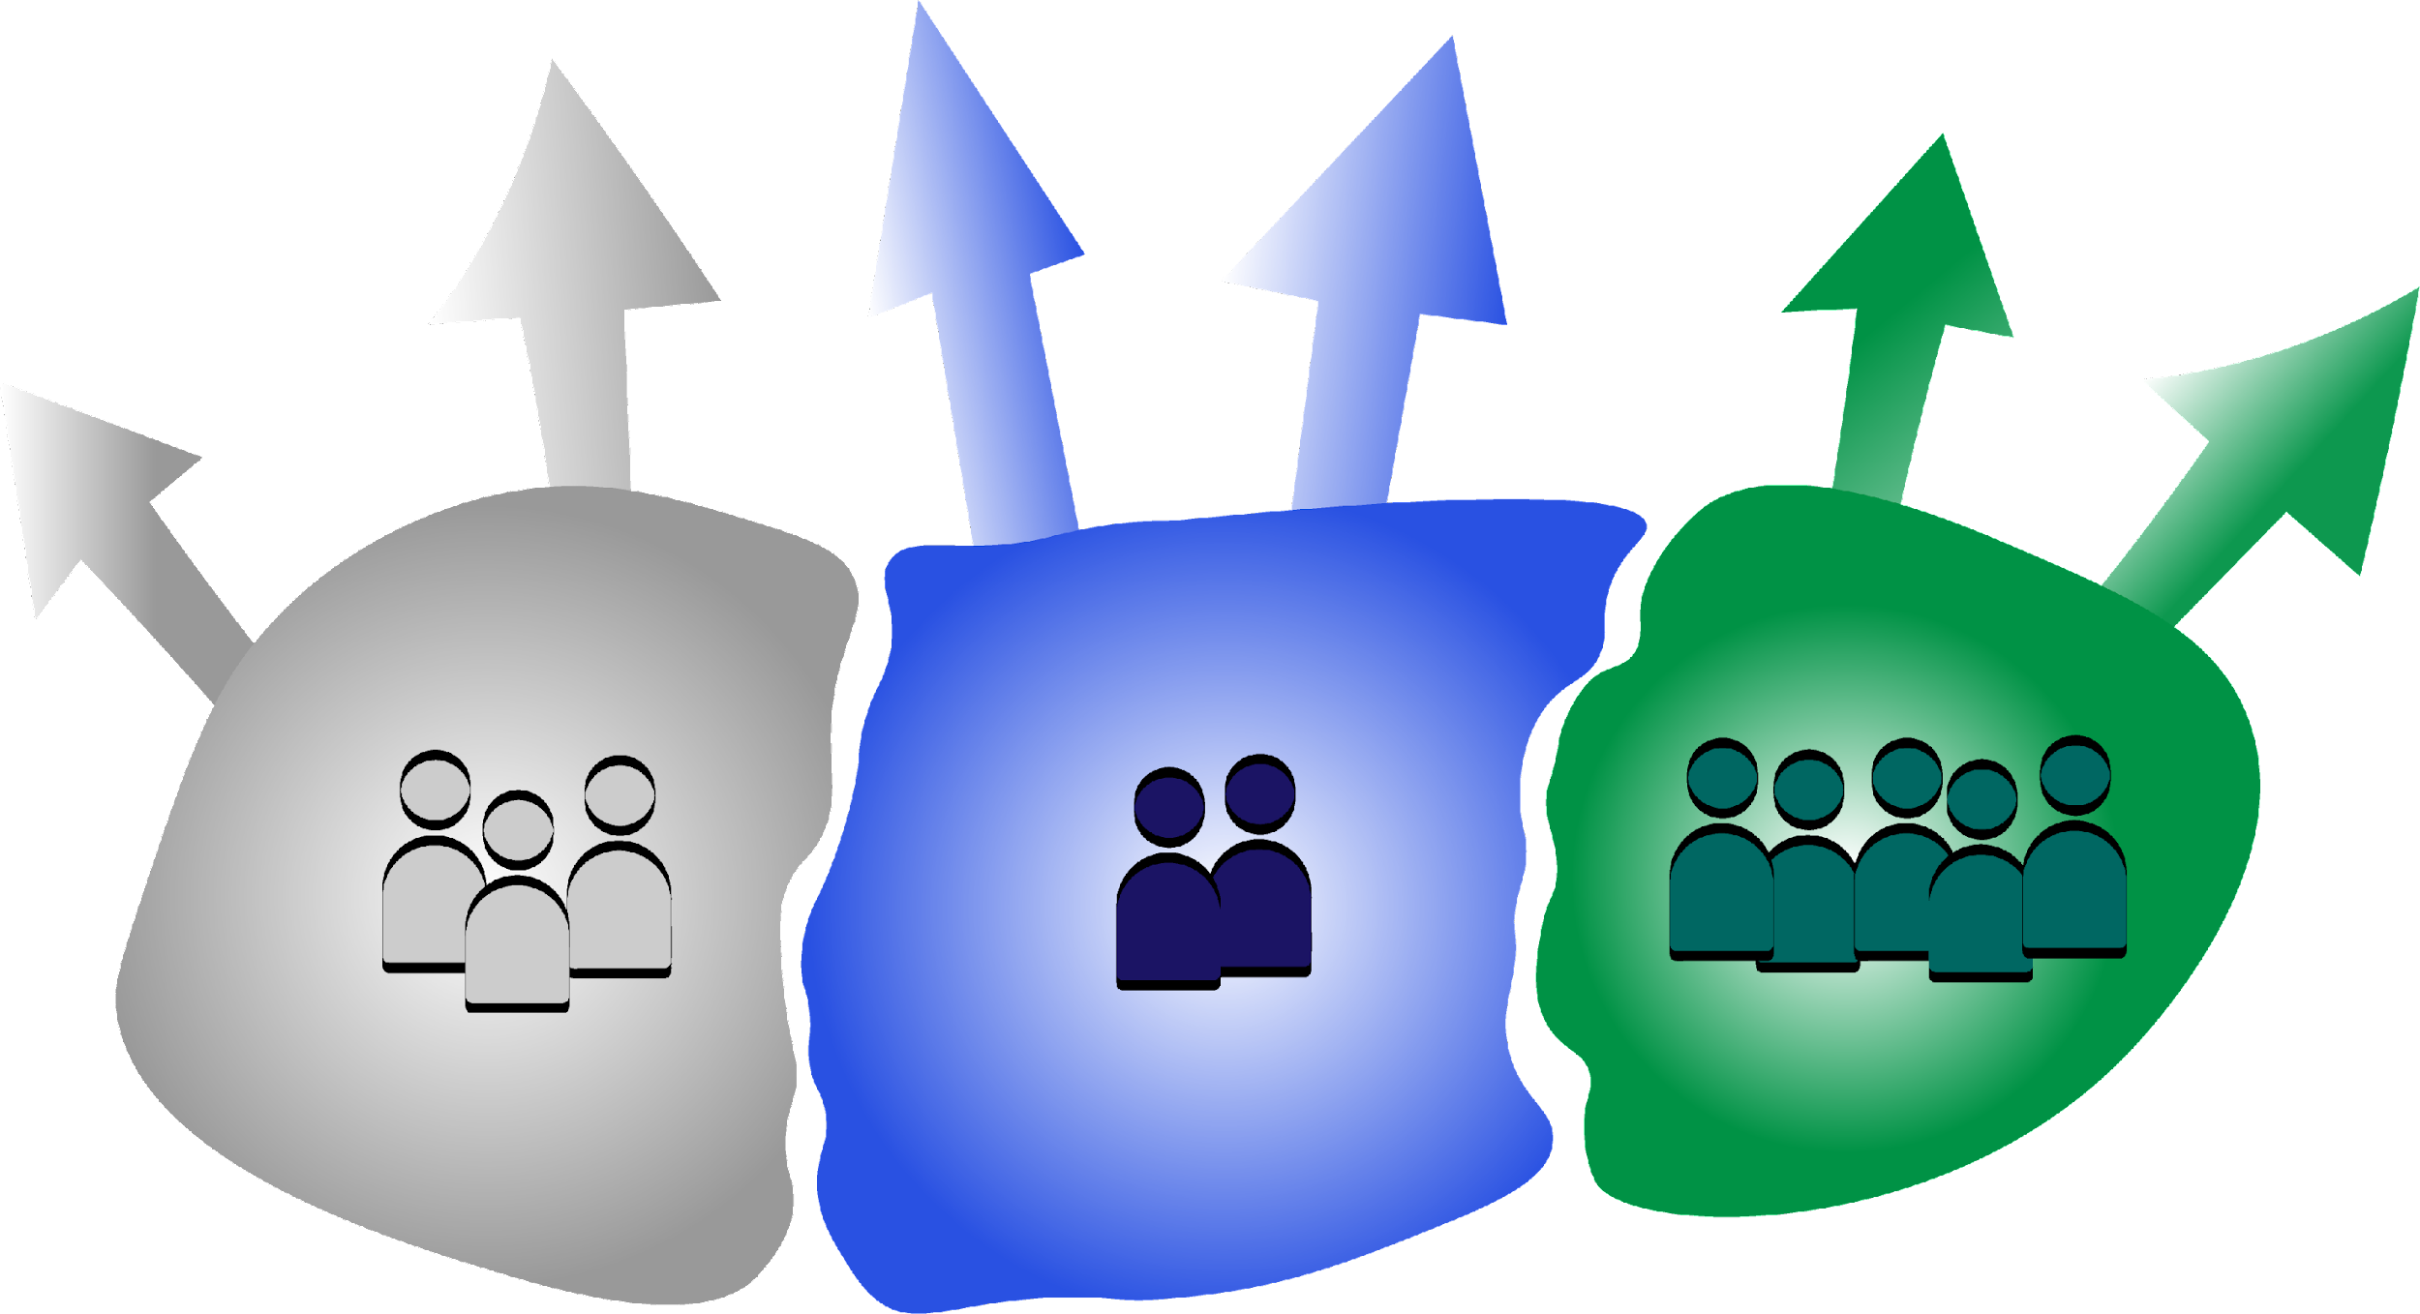
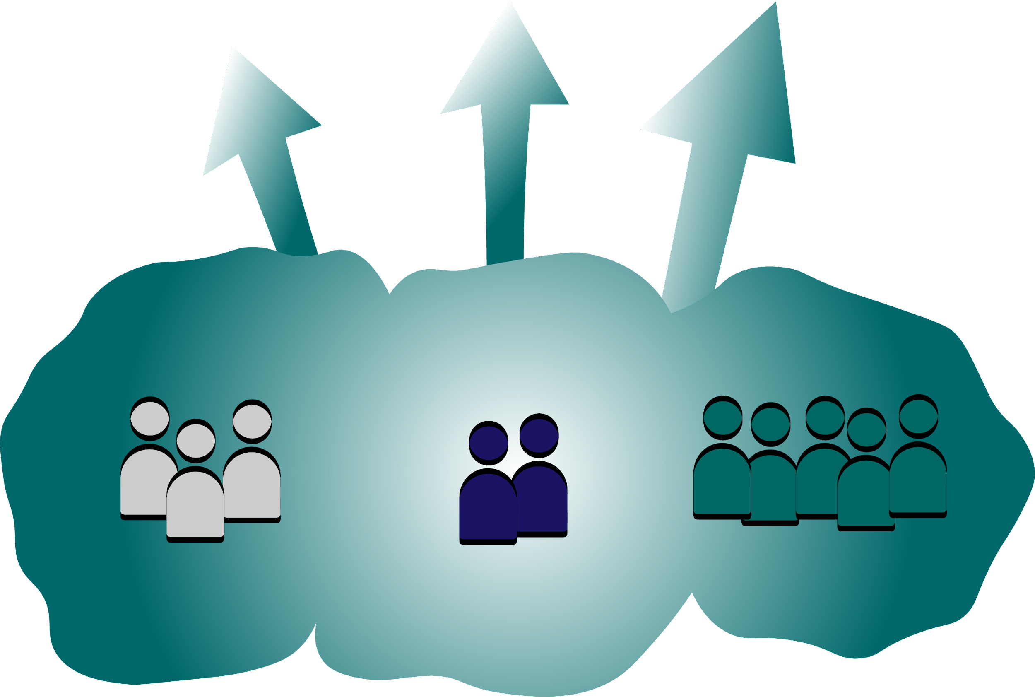
From silos to…
A shared understanding.

Slide 18

How can we shape the science-policy nexus for complex problems?

